Slide 1
How-To-Use: System Compliance Tool
MATLAB scripts needed:
system_compliance_check.m, system_compliance_xls.m, amp_spec_analysis.m, gain_spec_analysis.m, gd_spec_analysis.m, MaxAmpVar1.m, MaxGDVar1.m, Readcti.m, Readcti1.m, smooth.m, smooth1.m, Var.m, vswr_spec_analysis.m
Also needed:
system_compliance_template.xlt

Slide 2
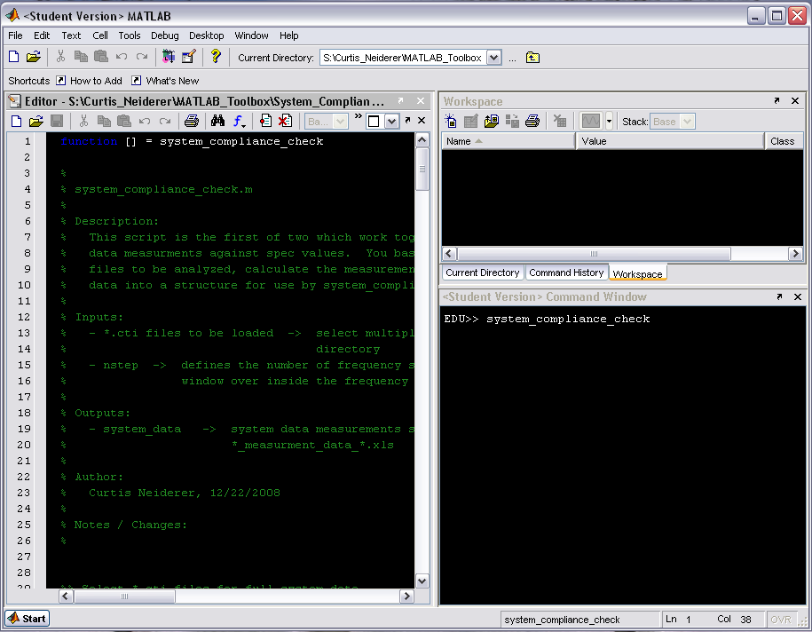
Type system_compliance_check at the command line

Slide 3
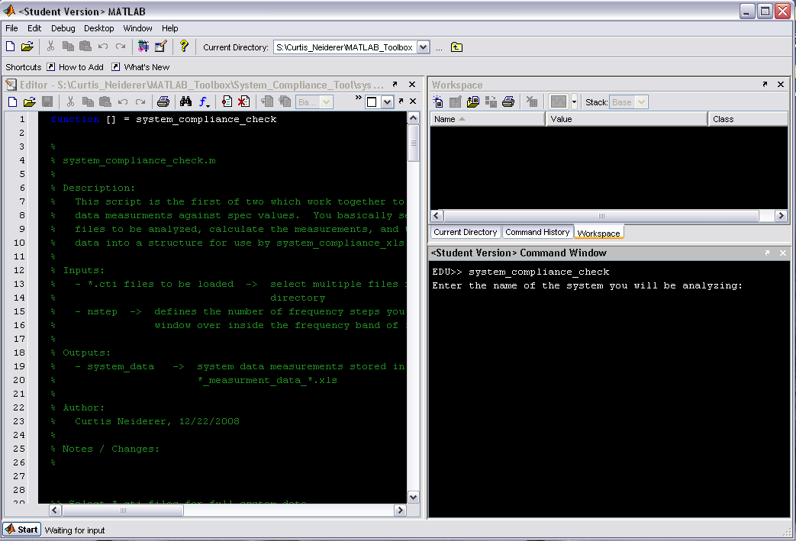
You will be prompted for the system name, enter it at the command line

Slide 4

You will be prompted for the system name, enter it at the command line

Slide 5
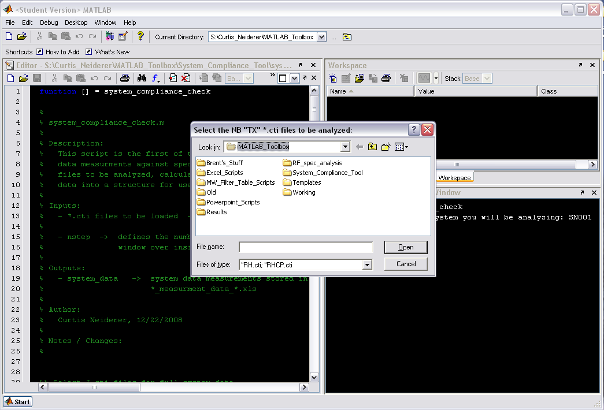
You will then be prompted to select the NB “TX” *.cti files

Slide 6
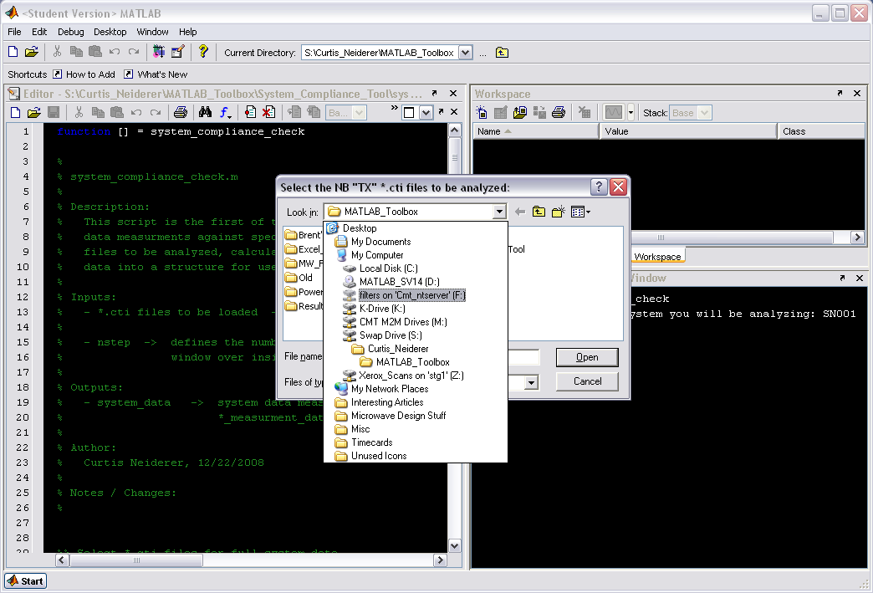
Browse to the location of the *.cti files

Slide 7
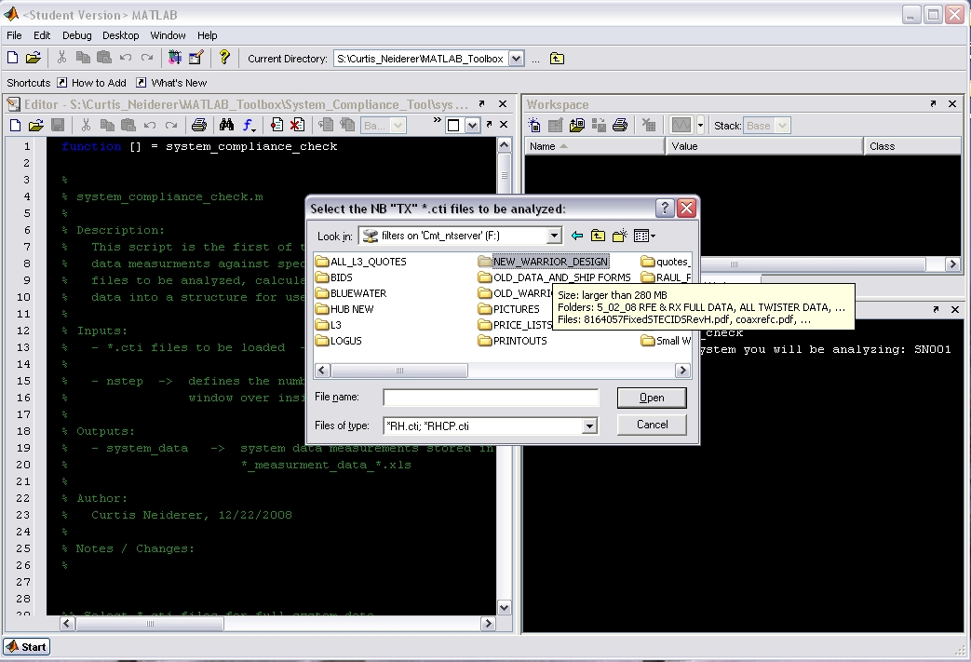

Slide 8
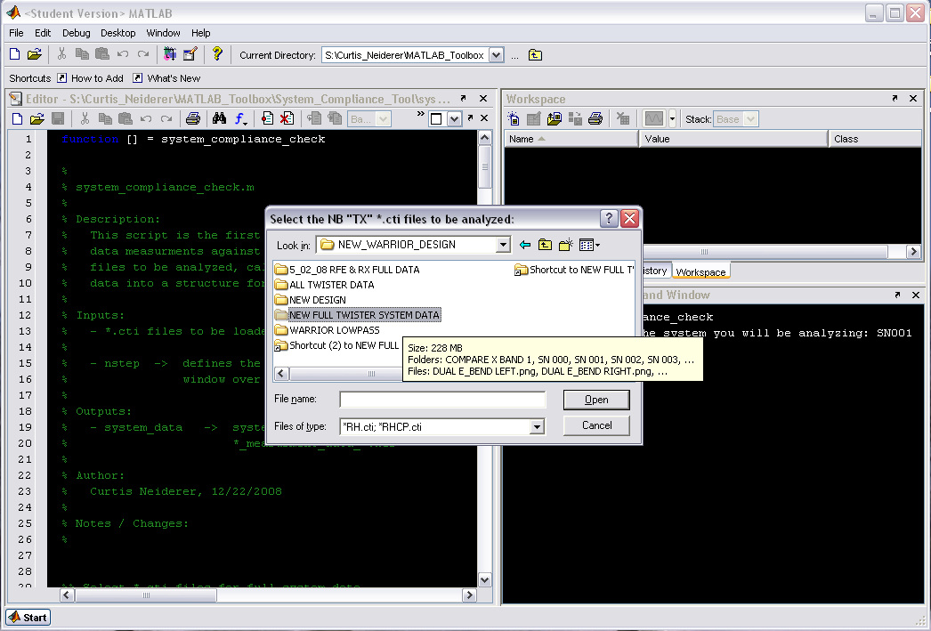

Slide 9
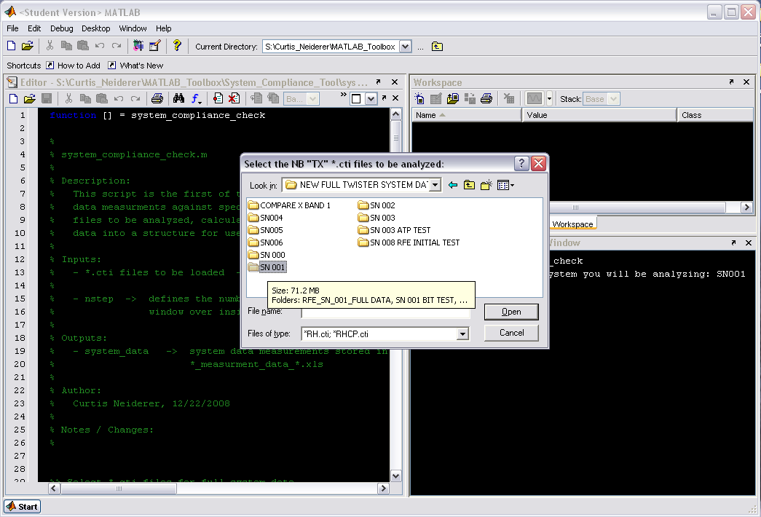

Slide 10
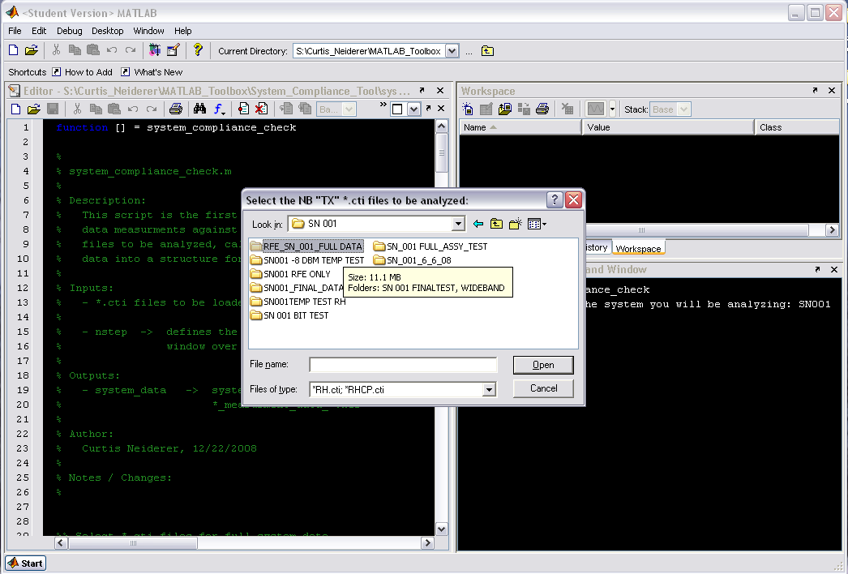

Slide 11
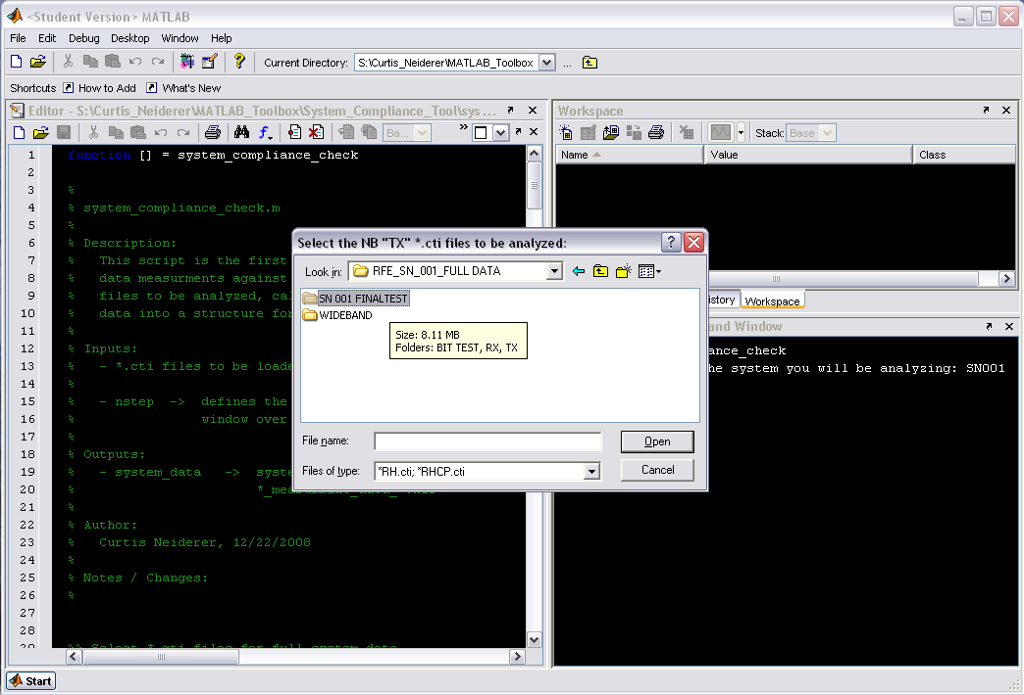

Slide 12
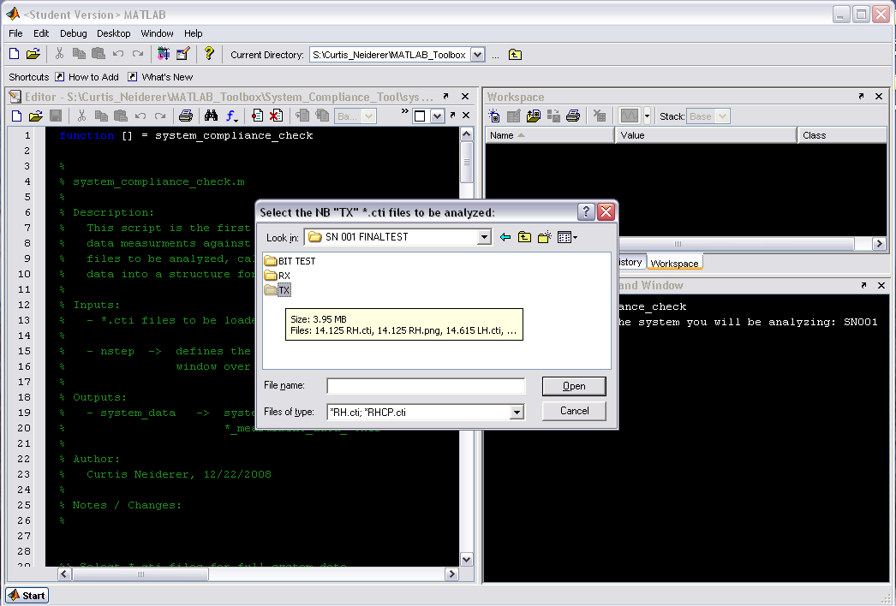

Slide 13
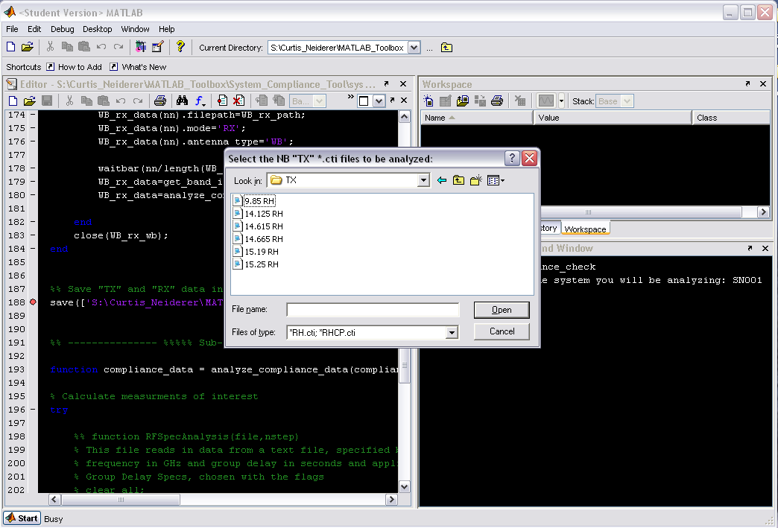
Select the NB “TX” *.cti files to be analyzed

Slide 14
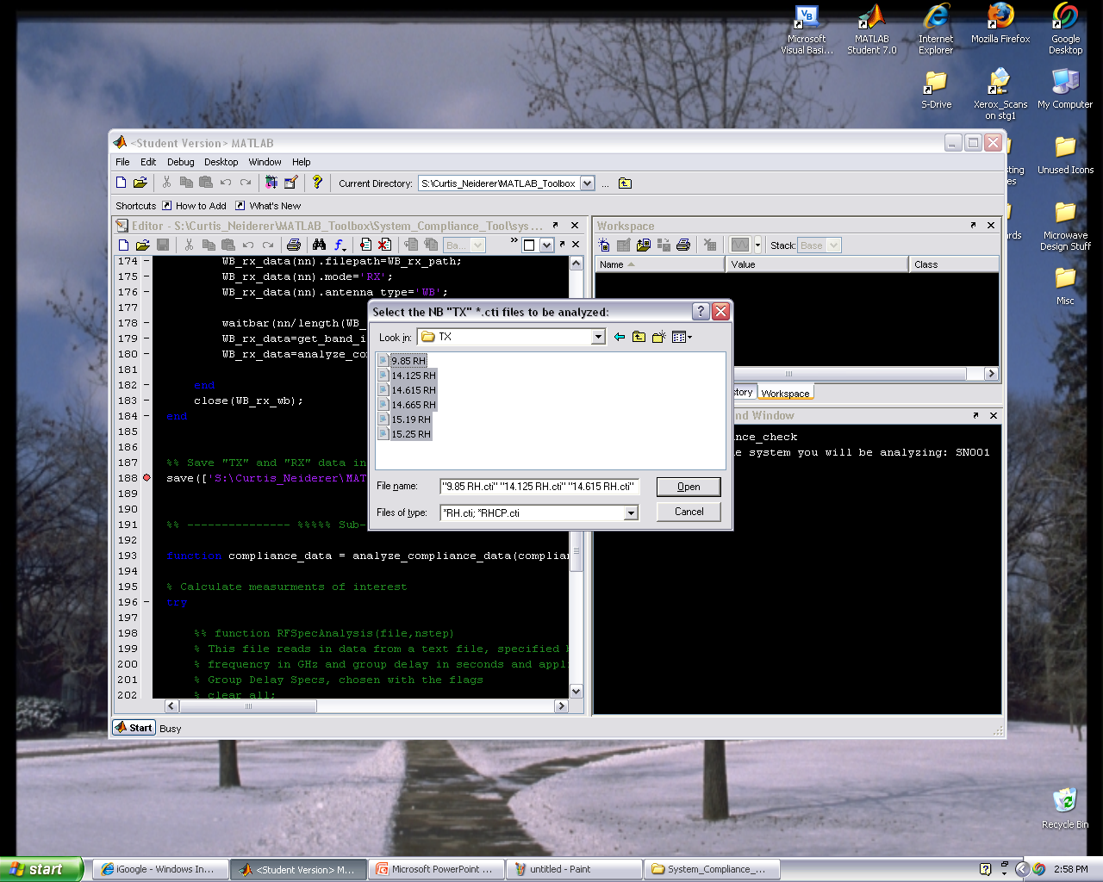
Highlight the files of interest, then click open

Slide 15
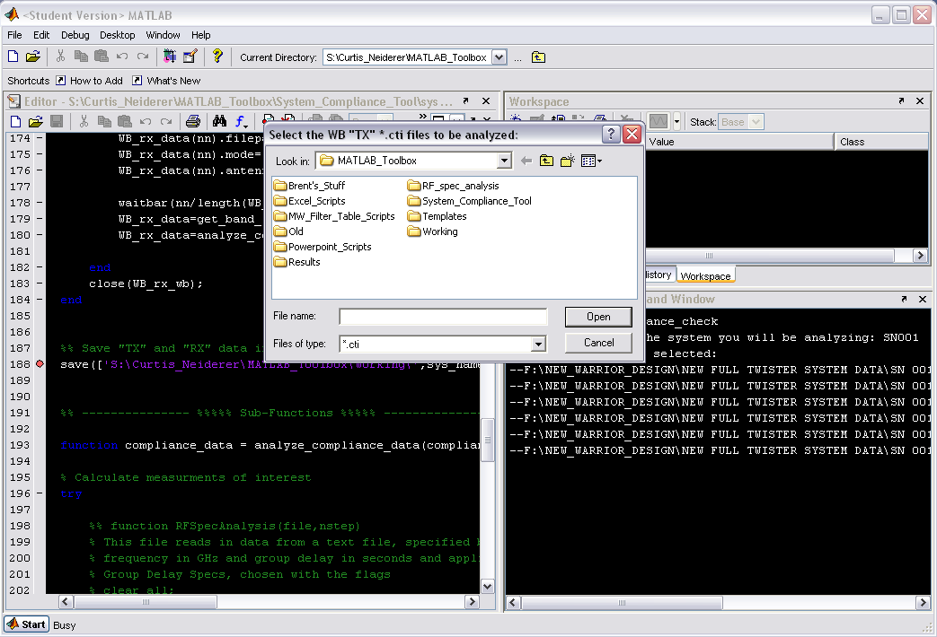
Follow same procedure for selecting WB “TX” *.cti files

Slide 16
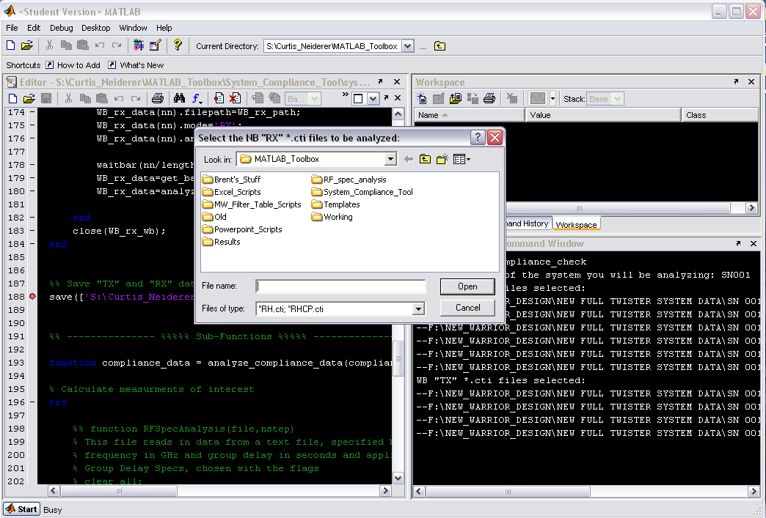
Again, repeat the procedure for the NB “RX” *.cti files

Slide 17
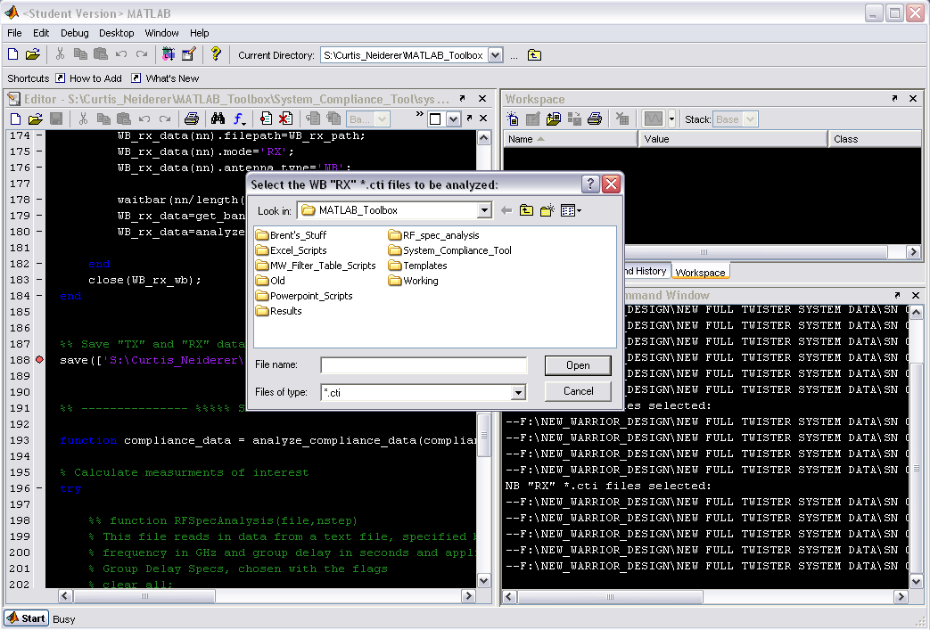
And one last time for the WB “RX” *.cti files

Slide 18
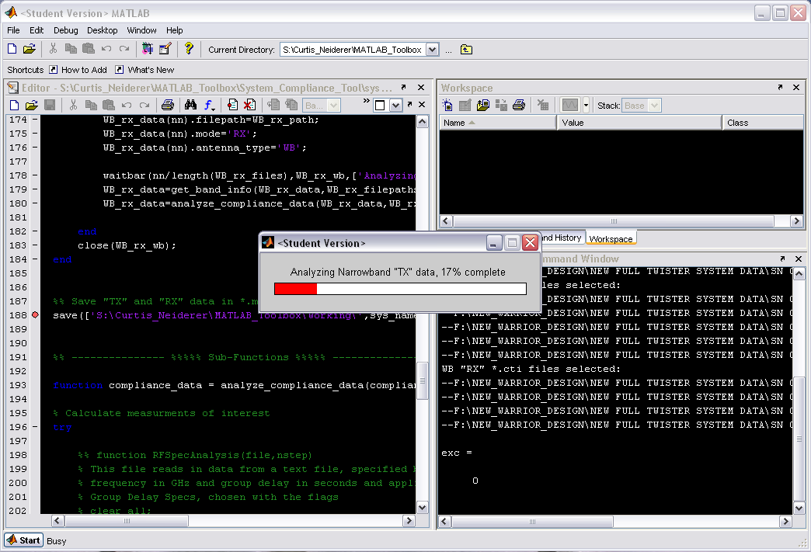
After file selection analysis will begin, you can follow the progress via the waitbars that pop-up

Slide 19
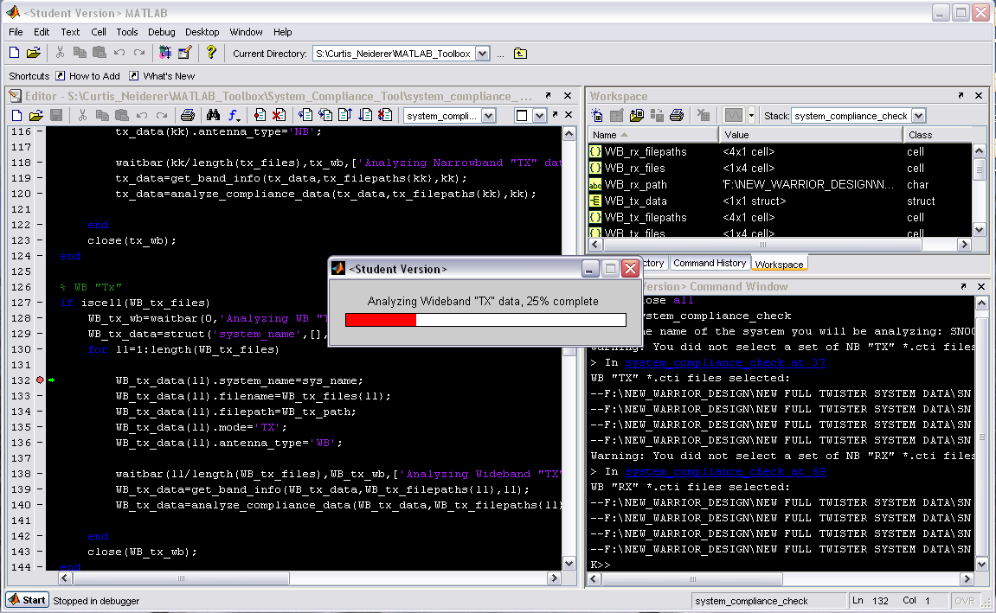

Slide 20
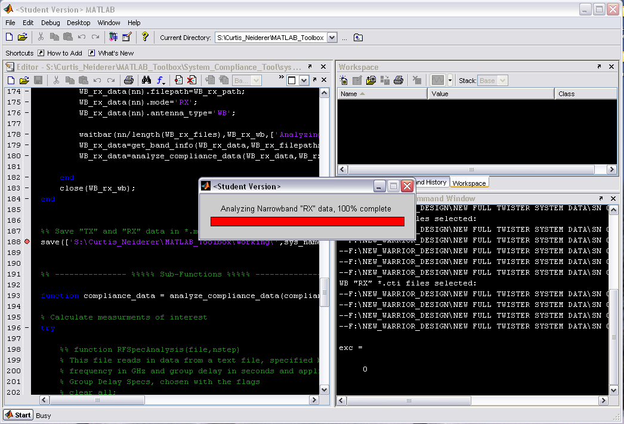

Slide 21
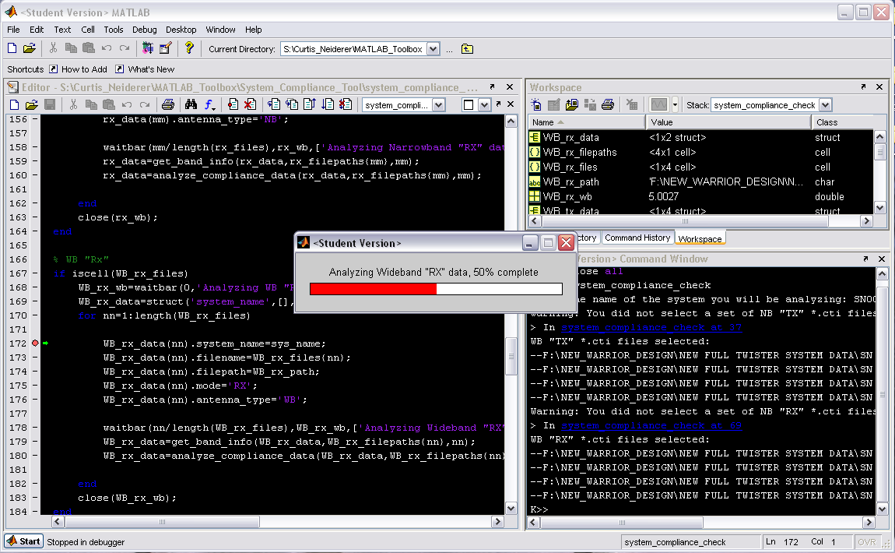

Slide 22
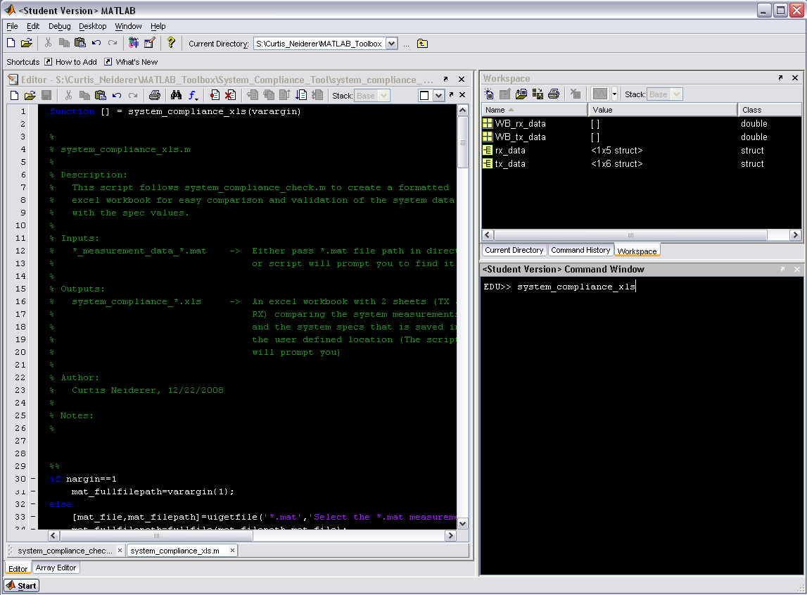
File analysis is now complete, type system_compliance_xls at the command line

Slide 23
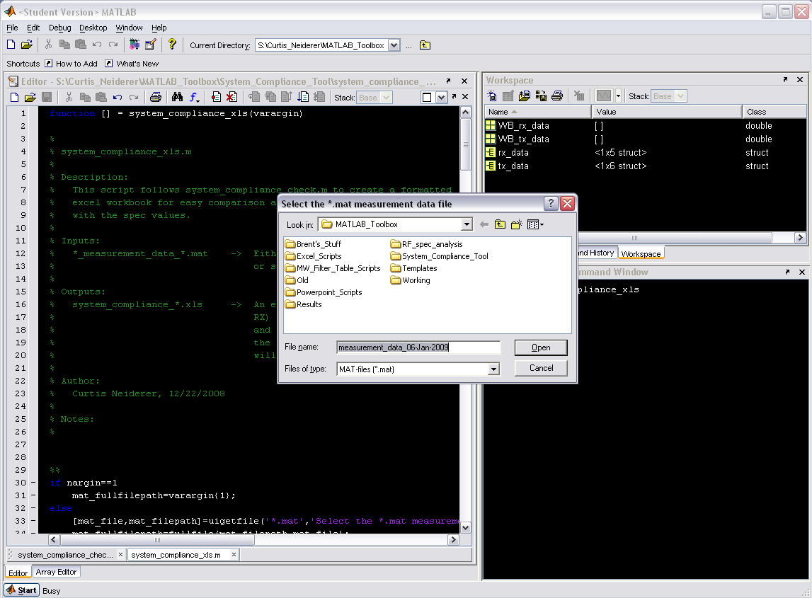
You will be prompted to select the *.mat file containing your measurement data. This was created in system_compliance_check

Slide 24
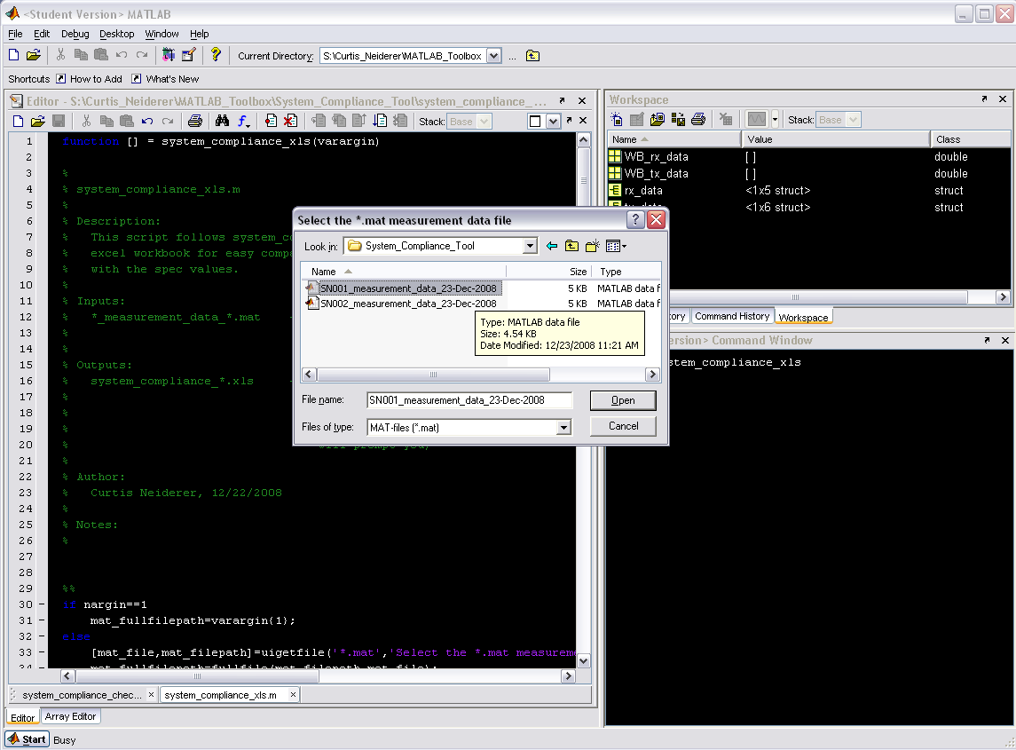
Browse to the location you saved your data and select the *.mat file

Slide 25
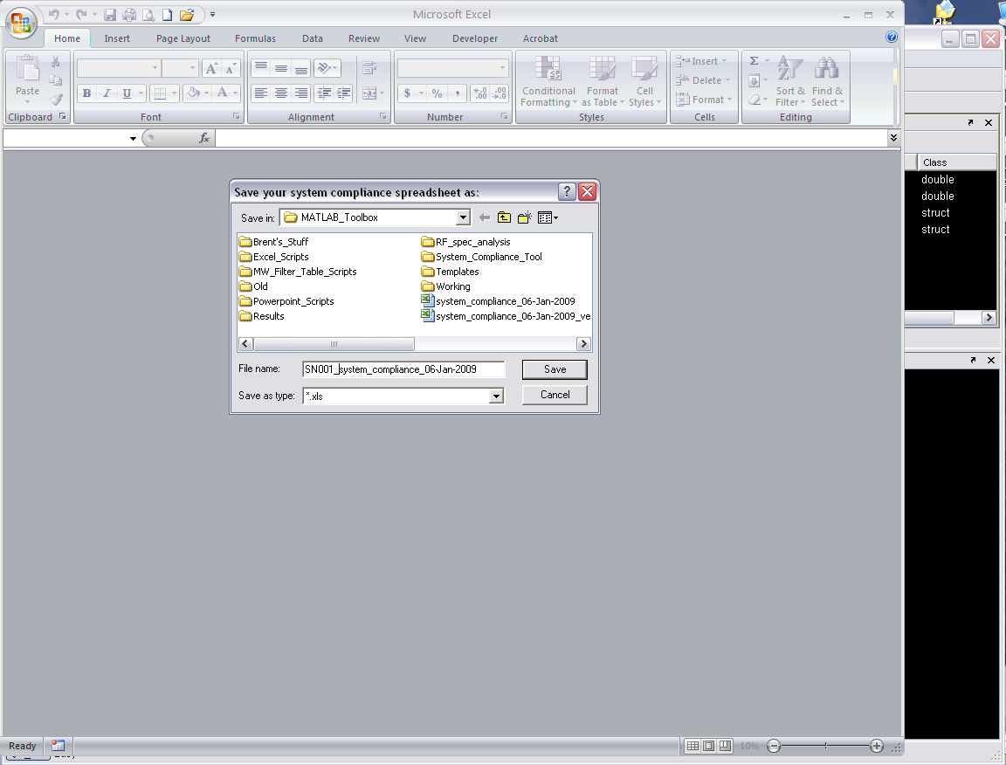
Chose a name and location to save your system compliance spreadsheet to

Slide 26
Congratulations, you’re done.

